Slide 1

A Generative AI-Enabled Multimodal Medical Report Explainer Improving Patient Comprehension and Clinical Decision Support
CSA6502-GENERATIVE AI FOR LARGE SCALE MODEL
GUIDED BY:
Dr. Nithisha J
PRESENT BY:
V . Venkata Karthik Reddy
P. V Sai Teja Reddy

Slide 2

INTRODUCTION
What it is — an AI pipeline that reads lab, radiology, and discharge reports and explains them in plain language.
How it works — document processing extracts structured data; generative AI turns it into patient-friendly, multimodal explanations.
Who it helps — patients gain clarity and confidence; clinicians gain a decision-support layer alongside their own judgment.

Slide 3
PROBLEM STATEMENT
Patients struggle to understand their own medical reports
Dense clinical jargon — lab results, radiology and pathology reports use technical terminology most patients cannot interpret without help.
Limited clinician time — doctors have only minutes per visit to explain findings, leaving many questions unanswered after the appointment.
One-size-fits-all format — reports are text-only and static, with no adaptation to a patient's language, literacy level, or preferred modality.

Slide 4
OBJECTIVES
Goals of the proposed generative AI explainer pipeline
Automated Data Extraction — apply OCR and named-entity recognition to convert scanned lab, radiology, and discharge reports into structured, standardized clinical data (ICD-10, LOINC).
Plain-Language Explanation — use generative AI to translate clinical findings into jargon-free explanations tailored to a patient's literacy level and language.
Multimodal, Accessible Delivery — present explanations as text, annotated visuals, and voice narration so patients can engage in their preferred format.
Safe Clinical Decision Support — surface abnormal values and follow-up questions while keeping clinicians in the loop through guardrails and validation checks.

Slide 5
Literature Review
Year | Authors | Research Title | Methods / Techniques | Key Contribution
2023 | Jeblick et al. | ChatGPT for Simplified Radiology Reports | ChatGPT, text simplification | Improved patient understanding of complex radiology reports.
2023 | Lyu et al. | Translating Radiology Reports into Plain Language | GPT-4, prompt learning | Generated patient-friendly medical explanations while highlighting factual-error risks.
2024 | Luo et al. | ReXplain: Patient-Friendly Radiology Reports | LLM, image segmentation, 3D visualization | Combined medical images and text to create multimodal patient explanations.
2024 | Hartsock & Rasool | Vision-Language Models in Healthcare | VLMs, Transformers, medical VQA | Demonstrated the potential of multimodal AI for medical image and text understanding.
2024 | Singhal et al. | Expert-Level Medical Question Answering | Med-PaLM 2, LLM, medical QA | Showed the potential of medical LLMs for clinical information and decision support.

Slide 6
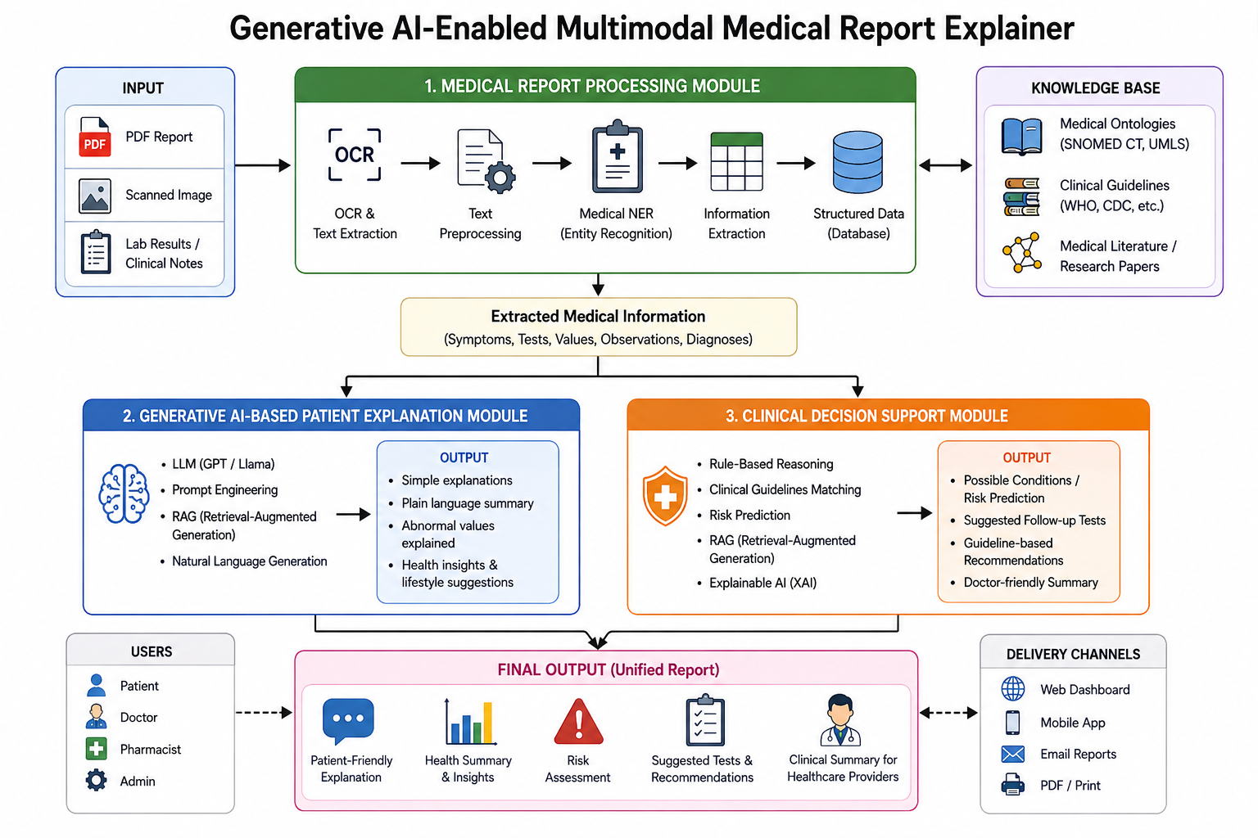
System Architecture

Slide 7
MODULE 1
Medical Report Processing Module
Converts raw, unstructured clinical documents into clean, structured medical data.
Ingest Report — accepts scanned PDFs, images, and typed reports (labs, radiology, discharge summaries).
OCR & Text Extraction — extracts raw text and key-value fields using OCR and layout-aware parsing.
Structuring & NER — named-entity recognition tags diagnoses, medications, values, and reference ranges.
Terminology Normalization — maps extracted terms to standard codes (ICD-10, LOINC) for consistency.

Slide 8
MODULE 2
Generative AI-Based Patient Explanation & Decision Support
Turns structured clinical data into clear, multimodal explanations and actionable guidance.
Plain-Language Explanation — LLM rewrites clinical findings into simple, jargon-free language tailored to patient literacy level and preferred language.
Multimodal Delivery — explanations delivered as text, annotated visuals/diagrams, and voice narration for accessibility.
Clinical Decision Support — highlights abnormal values, suggested next steps, and questions to raise with the physician.
Safety & Validation Layer — guardrails and clinician-in-the-loop review ensure explanations stay accurate, non-diagnostic, and safe.

Slide 9
TOOLS & TECHNIQUES
Key Technologies Powering the Pipeline
Combines document AI, generative language models, and multimodal delivery across both modules.
Document AI & OCR — layout-aware OCR and document parsing extract raw text and key-value fields from scanned lab, radiology, and discharge reports.
NLP & Terminology Normalization — clinical named-entity recognition tags diagnoses and values, mapped to standard ICD-10 and LOINC codes.
Generative AI / LLMs — GPT-4-class and fine-tuned language models rewrite findings in plain language and power the decision-support layer.
Multimodal & Evaluation Tools — text-to-speech narration, diagram generation, retrieval-augmented grounding, and readability metrics for validation.

Slide 10
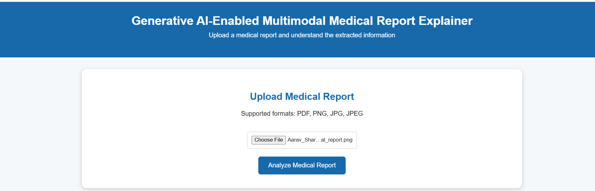
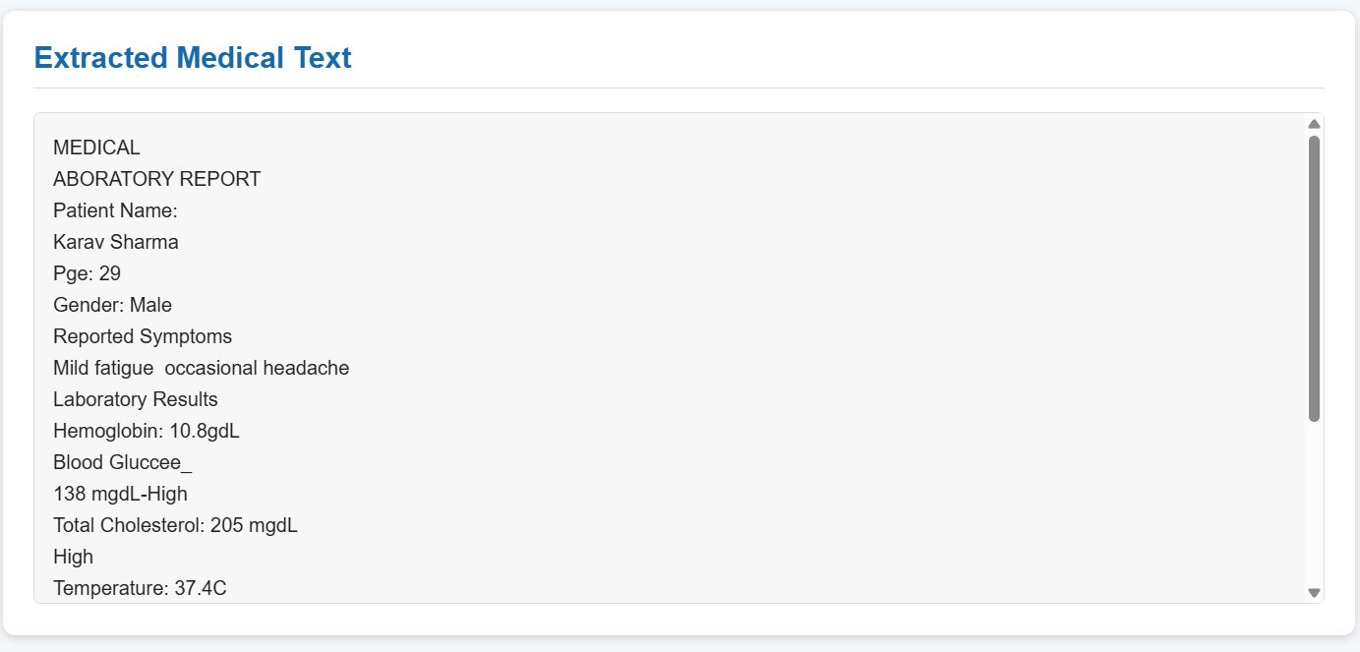
OUT PUT

Slide 11
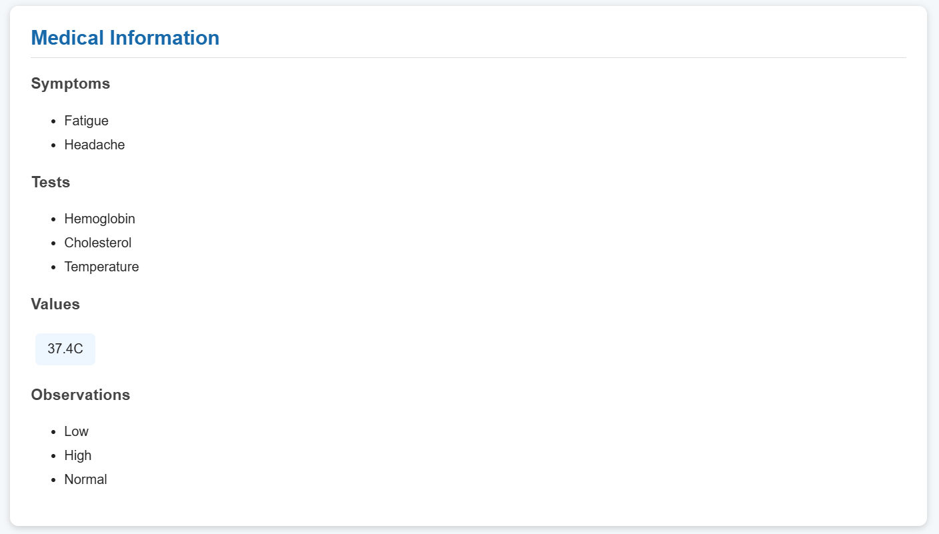
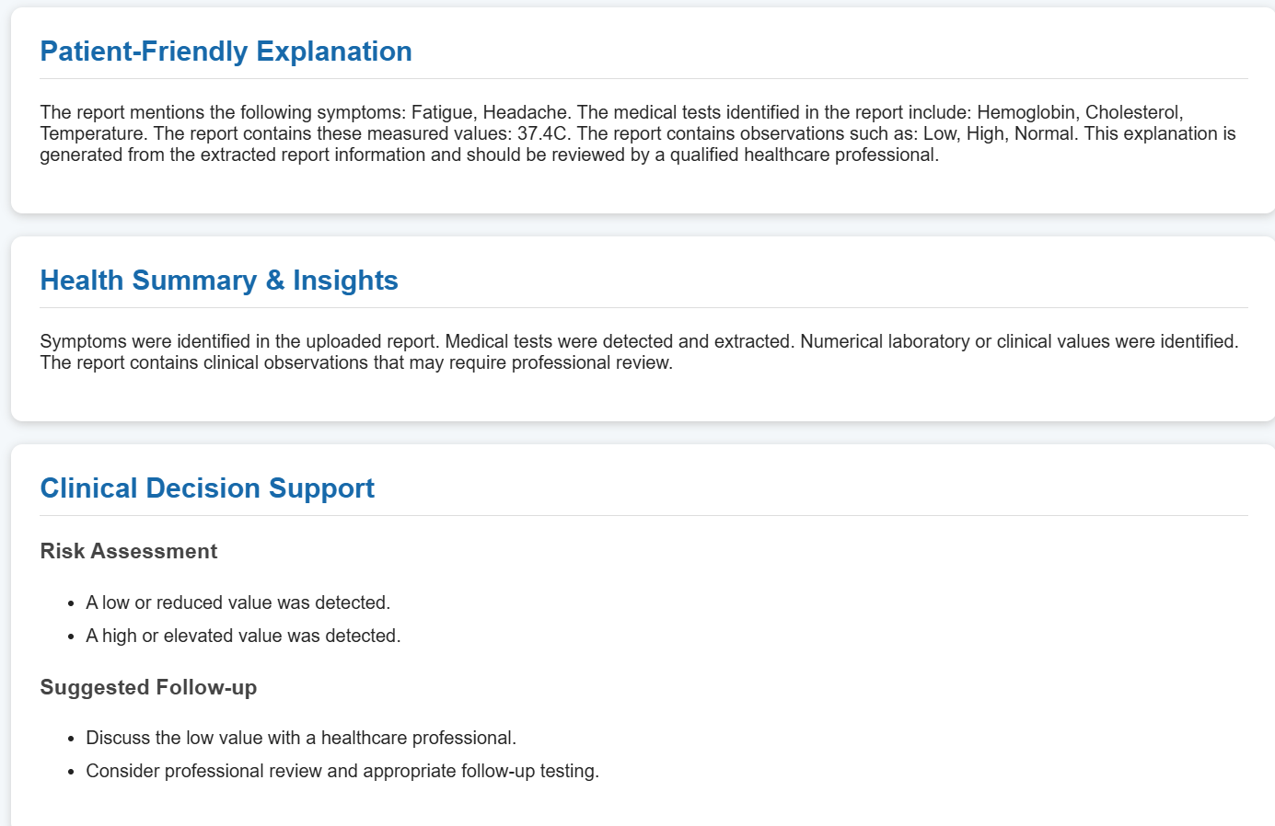

Slide 12

CONCLUSION
From confusing reports to confident patients
Combines document AI (Module 1) with generative explanation and decision support (Module 2) in one pipeline.
Improves patient comprehension, health literacy, and engagement in their own care.
Supports clinician judgment, with built-in safety and validation checks.
Scalable, multimodal foundation for future work: multilingual support, chronic-care tracking, and EHR integration.

Slide 13
REFERENCES
Selected literature, 2024–2025
1. Doshi R, Amin KS, Khosla P, et al. Quantitative evaluation of large language models to streamline radiology report impressions: a multimodal retrospective analysis. Radiology. 2024.
2. Jeblick K, Schachtner B, Dexl J, et al. ChatGPT makes medicine easy to swallow: an exploratory case study on simplified radiology reports. Eur Radiol. 2024;34:2817–2825.
3. Kuckelman IJ, Wetley K, Yi PH, et al. Translating musculoskeletal radiology reports into patient-friendly summaries using ChatGPT-4. Skeletal Radiol. 2024;53:1621–1624.
4. Maroncelli R, Rizzo V, Pasculli M, et al. Probing clarity: AI-generated simplified breast imaging reports for enhanced patient comprehension powered by ChatGPT-4o. Eur Radiol Exp. 2024;8:124.
5. Tariq A, Trivedi S, Urooj A, et al. Patient-centric summarization of radiology findings using two-step training of large language models. ACM Trans Comput Healthc. 2025;6:21.
6. Aydin S, Karabacak M, Vlachos V, Margetis K. Large language models in patient education: a scoping review of applications in medicine. Front Med (Lausanne). 2024;11:1477898.

